Slide 1
Part 2 Physical Layer and Media
Chapter 3 Data and Signals
Chapter 4 Digital Transmission
Chapter 5 Analog Transmission
Chapter 6 Bandwidth Utilization: Multiplexing and Spreading
Chapter 7 Transmission Media
Chapter 8 Switching
Chapter 9 Using Telephone and Cable Networks for Data
Transmission
3-<number>

Slide 2
Chapter 3. Data and Signals
Analog and Digital
Periodic Analog Signals
Digital Signals
Transmission Impairment
Data Rate Limits
Performance
3-<number>

Slide 3
Analog and Digital
To be transmitted, data must be transformed to electromagnetic signals
Data can be analog or digital. Analog data are continuous and take continuous values. Digital data have discrete states and take on discrete values.
Signals can be analog or digital. Analog signals can have an infinite number of values in a range; digital signals can have only a limited number of values.
3-<number>

Slide 4

Analog and Digital Signals
3-<number>

Slide 5
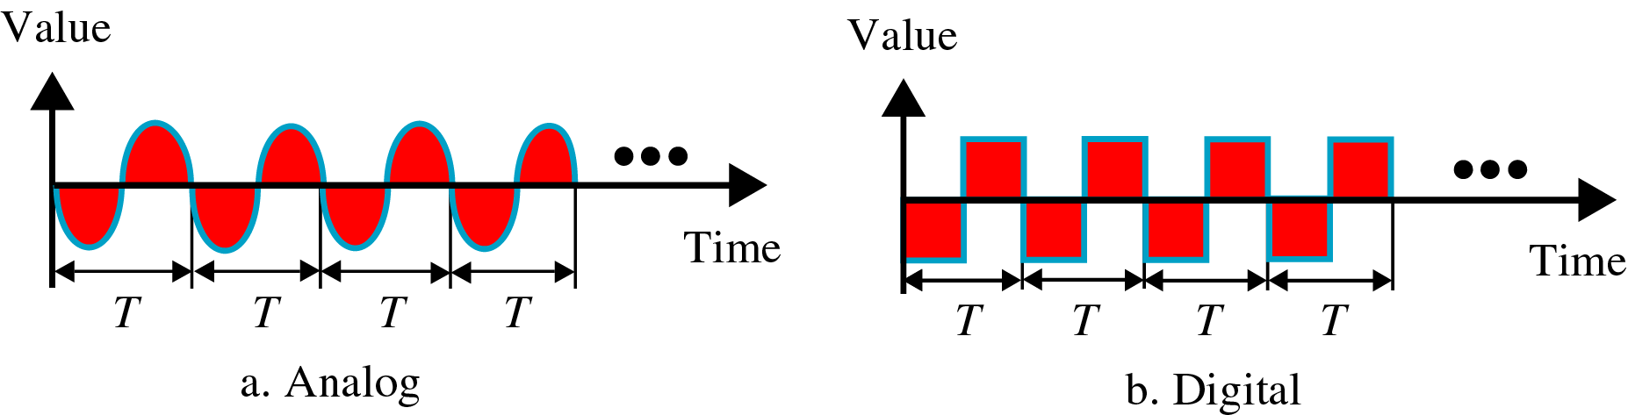
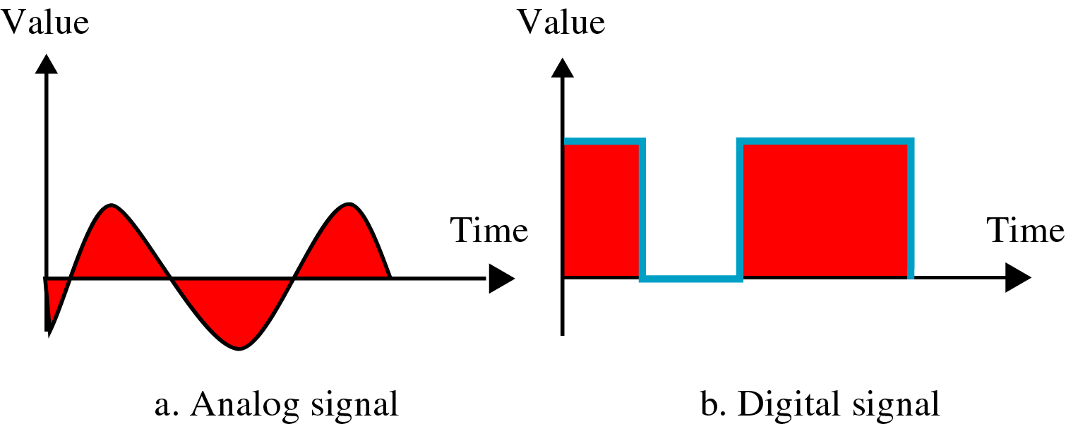
Periodic and Nonperiodic Signals
In data communication, we commonly use periodic analog signals and nonperiodic digital signals
3-<number>

Slide 6
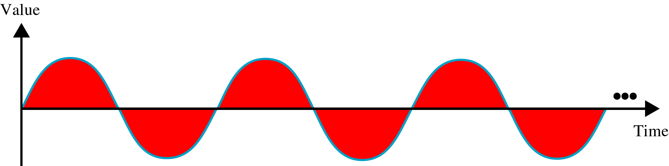
Periodic Analog Signals
Periodic analog signals can be classified as simple or composite.
A simple periodic analog signal, a sine wave, cannot be decomposed into simpler signals.
A composite periodic analog signal is composed of multiple sine waves
Sine wave is described by
  Amplitude
  Period (frequency)
  phase
3-<number>

Slide 7

Amplitude
3-<number>

Slide 8

Period and Frequency
Frequency and period are the inverse of each
3-<number>

Slide 9

Units of Period and Frequency
3-<number>

Slide 10
Example 3.5
Express a period of 100 ms in microseconds, and express the corresponding frequency in kilohertz
From Table 3.1 we find the equivalent of 1 ms. We make the following substitutions:
100 ms = 100 × 10⁻³ s = 100 × 10⁻³ × 10⁶ ms = 10⁵ μs
Now we use the inverse relationship to find the frequency, changing hertz to kilohertz
100 ms = 100 × 10⁻³ s = 10⁻¹ s
f = 1/10⁻¹ Hz = 10 × 10⁻³ KHz = 10⁻² KHz
3-<number>

Slide 11
More About Frequency
Another way to look frequency
  Frequency is a measurement of the rate of changes
  Change in a short span of time means high frequency
  Change over a long span of time means low frequency
Two extremes
  No change at all ⇒ zero frequency
  Instantaneous changes ⇒ infinite frequency
3-<number>

Slide 12

Phase
Phase describes the position of the waveform relative to time zero
3-<number>

Slide 13
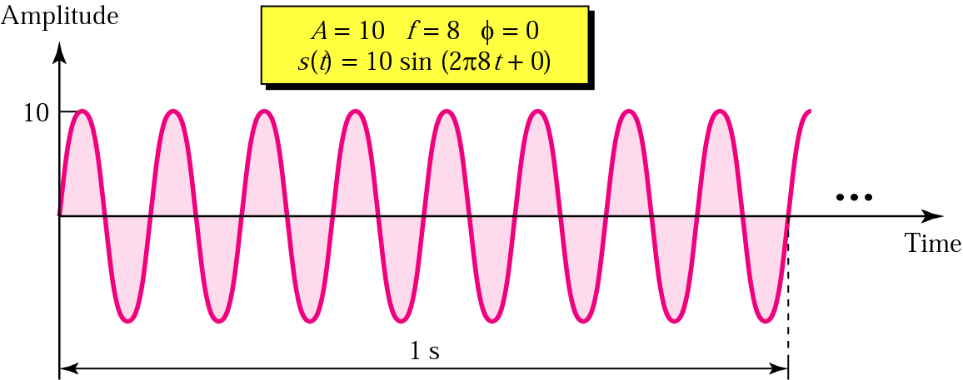
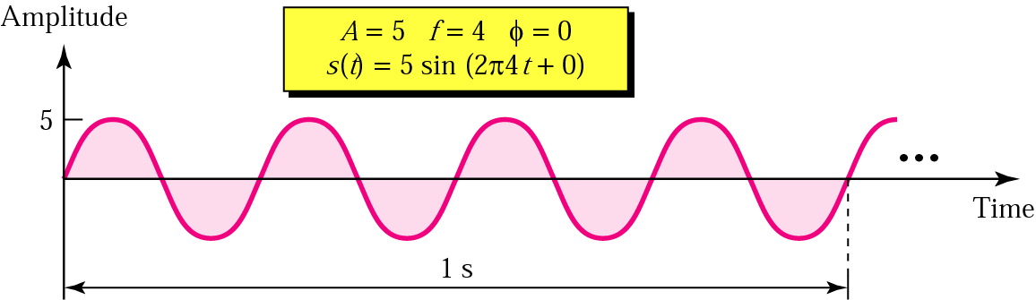
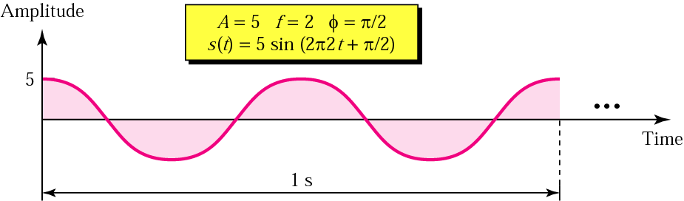
Sine Wave Examples
3-<number>

Slide 14
Example 3.6
A sine wave is offset one-sixth of a cycle with respect to time zero. What is its phase in degrees and radians?
We know that one complete cycle is 360 degrees.
Therefore, 1/6 cycle is
(1/6) 360 = 60 degrees = 60 x 2π /360 rad = 1.046 rad
3-<number>

Slide 15

Wavelength
Another characteristic of a signal traveling through a transmission medium
Binds the period or the frequency of a simple sine wave to the propagation speed of the medium
Wavelength = propagation speed x period
= propagation speed/frequency
3-<number>

Slide 16

Time and Frequency Domains
A complete sine wave in the time domain can be represented by one single spike in the frequency domain
3-<number>

Slide 17

Example 3.7
Time domain and frequency domain of three sine waves with frequencies 0, 8, 16
3-<number>

Slide 18

Bandwidth
The bandwidth of a composite signal is the difference between the highest and the lowest frequencies contained in that signal
3-<number>

Slide 19
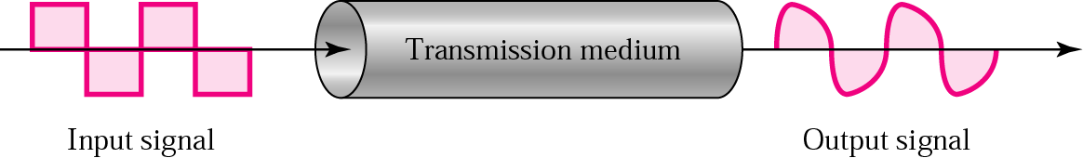
Signal Corruption
3-<number>

Slide 20
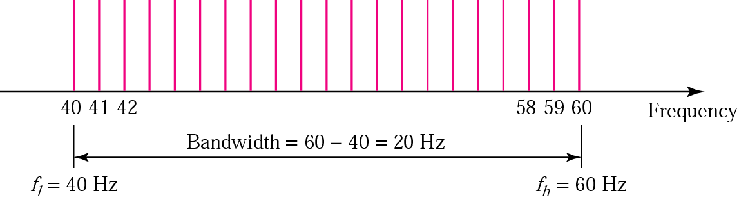
Example 3.11
A signal has a bandwidth of 20 Hz. The highest frequency is 60 Hz. What is the lowest frequency? Draw the spectrum if the signal contains all integral frequencies of the same amplitude
B = f_{h} - f_{l}, 20 = 60 – f_{l}, f_{l} = 60 - 20 = 40 Hz
3-<number>

Slide 21

Digital Signals
3-<number>

Slide 22
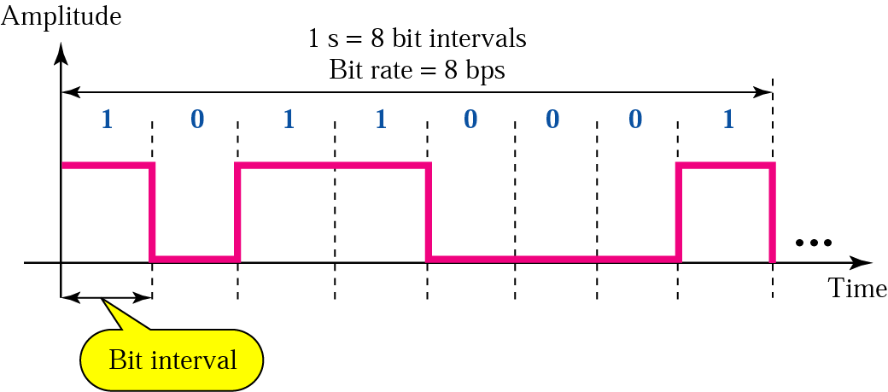
Bit Rate and Bit Interval
3-<number>

Slide 23

Transmission of Digital Signals
A digital signal is a composite analog signal with an infinite bandwidth
Baseband transmission: Sending a digital signal without changing into an analog signal
3-<number>

Slide 24

Low-Pass Channel with Limited Bandwidth
Rough approximation
3-<number>

Slide 25

Transmission Impairment
3-<number>

Slide 26

Attenuation
Loss of energy to overcome the resistance of the medium: heat
3-<number>

Slide 27


Decibel
Example 3.26: Suppose a signal travels through a transmission medium and its power is reduced to one-half. This means that P₂ is (1/2)P₁. In this case, the attenuation (loss of power) can be calculated as
Example 3.28
3-<number>

Slide 28

Distortion
The signal changes its form or shape
Each signal component in a composite signal has its own propagation speed
Differences in delay may cause a difference in phase
3-<number>

Slide 29

Noise
Several types of noises, such as thermal noise, induced noise, crosstalk, and impulse noise, may corrupt the signal
3-<number>

Slide 30

Signal-to-Noise Ratio (SNR)
To find the theoretical bit rate limit
SNR = average signal power/average noise power
SNR_{dB} = 10 log₁₀ SNR
Example 3.31: The power of a signal is 10 mW and the power of the noise is 1 μW; what are the values of SNR and SNR_{dB} ?
Solution:
3-<number>

Slide 31

Two Cases of SNRs
3-<number>

Slide 32
Data Rate Limits
Data rate depends on three factors:
  Bandwidth available
  Level of the signals we use
  Quality of the channel (the noise level)
Noiseless channel: Nyquist Bit Rate
  Bit rate = 2 * Bandwidth * log₂L
  Increasing the levels may cause the reliability of the system
Noisy channel: Shannon Capacity
  Capacity = Bandwidth * log₂(1 + SNR)
3-<number>

Slide 33
Nyquist Bit Rate: Examples
Consider a noiseless channel with a bandwidth of 3000 Hz transmitting a signal with two signal levels. The maximum bit rate can be calculated as
Bit Rate = 2 × 3000 × log₂ 2 = 6000 bps
Consider the same noiseless channel, transmitting a signal with four signal levels (for each level, we send two bits). The maximum bit rate can be calculated as:
Bit Rate = 2 x 3000 x log₂ 4 = 12,000 bps
3-<number>

Slide 34
Shannon Capacity: Examples
Consider an extremely noisy channel in which the value of the signal-to-noise ratio is almost zero. In other words, the noise is so strong that the signal is faint. For this channel the capacity is calculated as
C = B log₂ (1 + SNR) = B log₂ (1 + 0) = B log₂ (1) = B × 0 = 0
We can calculate the theoretical highest bit rate of a regular telephone line. A telephone line normally has a bandwidth of 3000 Hz (300 Hz to 3300 Hz). The signal-to-noise ratio is usually 3162. For this channel the capacity is calculated as
C = B log₂ (1 + SNR) = 3000 log₂ (1 + 3162) = 3000 log₂ (3163)
C = 3000 × 11.62 = 34,860 bps
3-<number>

Slide 35
Using Both Limits
The Shannon capacity gives us the upper limit; the Nyquist formula tells us how many signal levels we need.
Example: We have a channel with a 1 MHz bandwidth. The SNR for this channel is 63; what is the appropriate bit rate and signal level?
  First, we use the Shannon formula to find our upper limit
  C = B log₂ (1 + SNR) = 106 log₂ (1 + 63)
  = 106 log₂ (64) = 6 Mbps
  Then we use the Nyquist formula to find the
  number of signal levels
  4 Mbps = 2 × 1 MHz × log₂ L ➔ L = 4
3-<number>

Slide 36
Performance
Bandwidth (in two contexts)
  Bandwidth in hertz, refers to the range of frequencies in a composite signal or the range of frequencies that a channel can pass.
  Bandwidth in bits per second, refers to the speed of bit transmission in a channel or link.
Throughput
  Measurement of how fast we can actually send data through a network
Latency (Delay)
  Define how long it takes for an entire message to completely arrive at the destination from the time the first bit is sent out from the source
  Latency = propagation time + transmission time + queuing time + processing delay
  Propagation time = Distance/Propagation speed
  Transmission time = Message size/Bandwidth
Jitter
3-<number>

Slide 37

Bandwidth-Delay Product
The bandwidth-delay product defines the number of bits that can fill the link
3-<number>

Slide 38


Bandwidth-Delay Product
Bandwidth-delay product concept
3-<number>

